Slide 1

AAA Cross Selling Opportunities
ISA 460 - Big Data Analytics
Sean Lohle, Luke Therieau, Malthe Helt, Edmilson Da Moura, Cadri Folami
Notes:
malthe

Slide 2

Agenda
Data Background
Project Objectives
Model Building
Methodology
Analysis
Results
Recommendations
Notes:
malthe

Slide 3
Data Background
AAA Northeast (AAANE)
3rd largest AAA club in the US
Over 60 branches in this region
Newly built (CRM) system
The Individuals dataset is primarily provided by 3rd party (Experian credit bureau)
Member and business line data comes from what the AAA customer has provided
Notes:
malthe

Slide 4

Project Objective:
Analyze potential cross-sell opportunities between Auto Loan and Auto Insurance datasets to target the most appropriate individuals
Notes:
Malthe

Slide 5
Methodology
Step 1: ETL and Data Exploration
Loaded, cleaned, and transformed dataset
Explored data using visualization tools
Step 2: Pre-processing/Feature Engineering
Prepared data for analysis
Dealt with outliers and missing values
Step 3: Modelling Building/Tuning
Built random forest/GBT model
Refined model by adjusting the hyper-parameters
Step 4: Evaluation/Results
Created report
Included recommendations
Notes:
Cadri

Slide 6
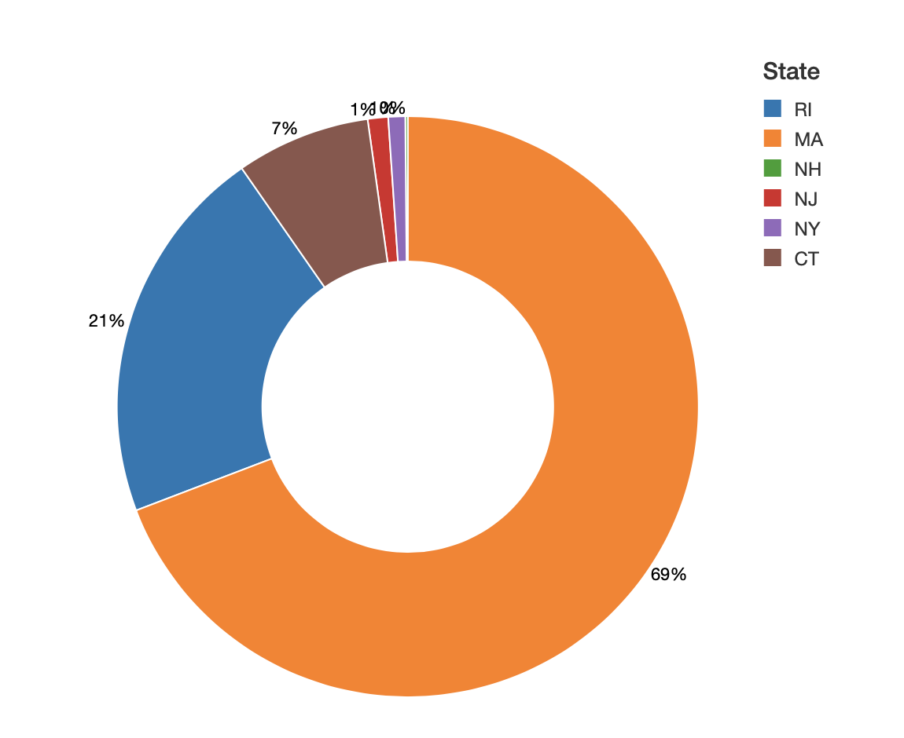
Data Exploration: Auto Loan
Auto Loans by State
Findings
Majority of the data comes from Massachusetts - 69%
NY and NJ have the lowest Auto Loan percentage compared to the other states
Higher focus on states with the most number of purchases
Rhode Island is the second highest number of auto loan purchases
Notes:
Edii

Slide 7
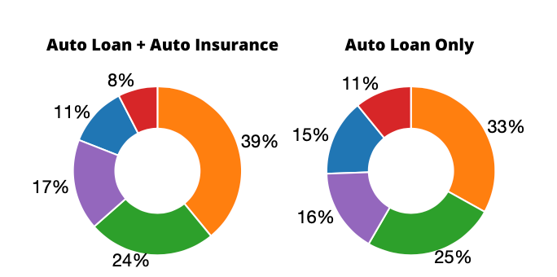
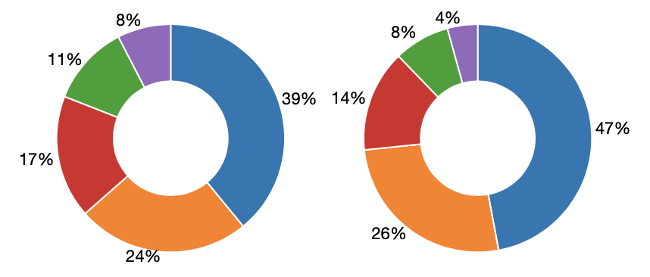
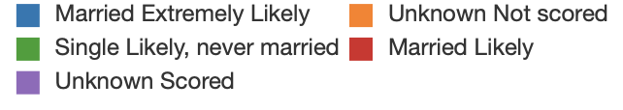
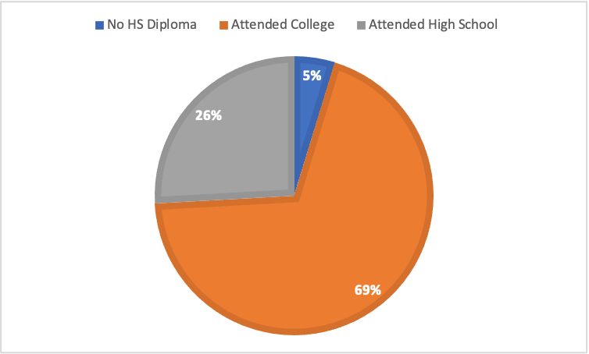
Data Exploration: Auto Loan Demographics
Marital Status
Findings
56% are more likely to be married when purchasing auto loan + auto insurance
61% are more likely to be married when purchasing auto loan only
69% attend at least some college while only 5% of auto loan purchases come from people with less than a HS diploma
Auto loan school demographics
Notes:
Edii

Slide 8
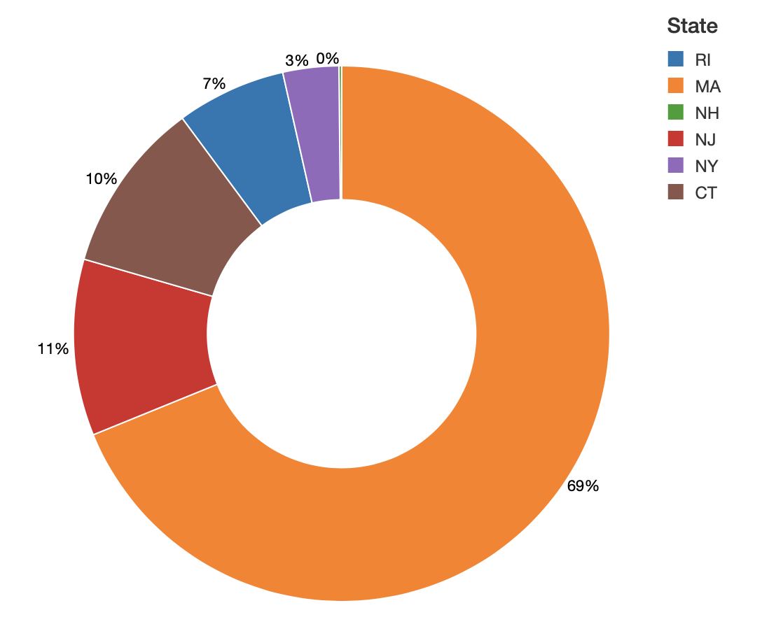
Data Exploration: Auto Insurance
Auto Insurance by State
Findings
Majority of the data comes from Massachusetts - 69%
NH and NY have the lowest Auto Insurance percentage compared to the other states
In this case, NJ and CT have the second most number of auto loan insurance compared to auto loan
Notes:
Edii

Slide 9
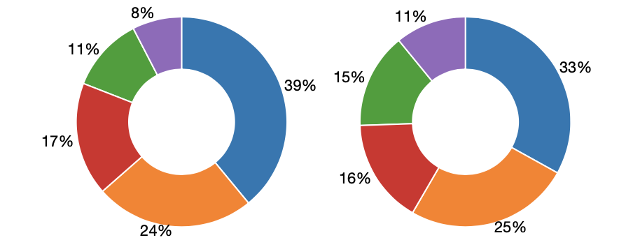
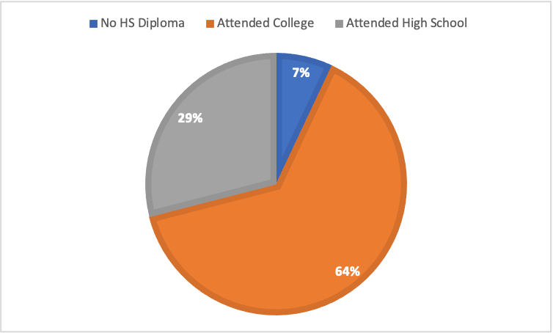
Data Exploration: Auto Insurance Demographics
Marital Status
Findings
56% are more likely to be married when purchasing auto loan + auto insurance
49% are more likely to be married when purchasing auto insurance only
64% attend at least some college while only 7% of auto insurance purchases come from people with less than a HS diploma
Auto insurance school demographics
Notes:
Edii

Slide 10
Building the Model
Auto Loan vs. Auto Loan and Insurance
Notes:
Luke

Slide 11
Features Included - Auto Loan vs. Both Products
Individual
Emails Received
State
Mortgage Flag
Credit Card Flag
Count Clicks or Opens
Mortgage Count
ID Theft Flag
Emails Received
Household
Est. Household Income
Auto In The Market - New
Demographics
Exact Age Decode
Priceline Count
Education Model
Occupation Group
Marital Status
Members
Member Tenure Years
ERS ENT Count Year 1
Member Excessive Use Flag
Member_Type
Member Tenure Years
Auto Loan
Lead Source
Borrower Length of Employment
Notes:
Sean
recall= TP/TP + FN
Precision= TP/TP+FP
https://www.datascienceblog.net/post/machine-learning/interpreting-roc-curves-auc

Slide 12
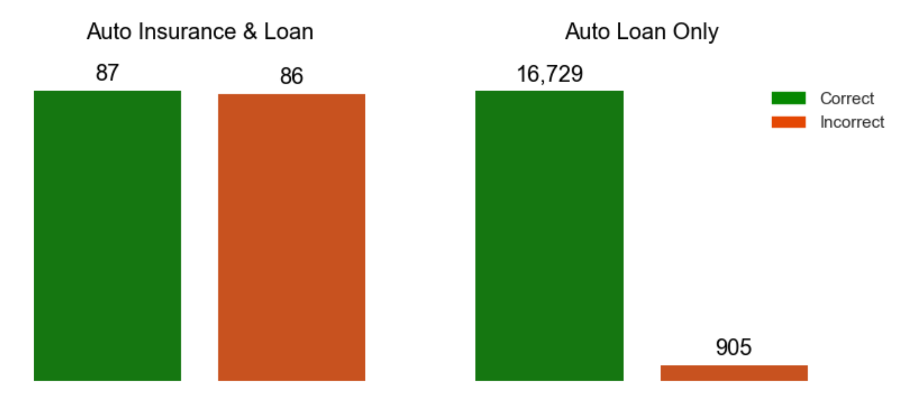
Random Forest - Auto Loan vs. Both Products
Findings
94.43% of all predictions were correct.
50.28% of all predictions for customers having both policies were correct.
Of all actual customers who had both policies, we predicted 8.7% of them correctly.
Notes:
Luke
recall= TP/TP + FN True Positive predicted compared to all true positives
Precision= TP/TP+FP Of all positive predictions

Slide 13
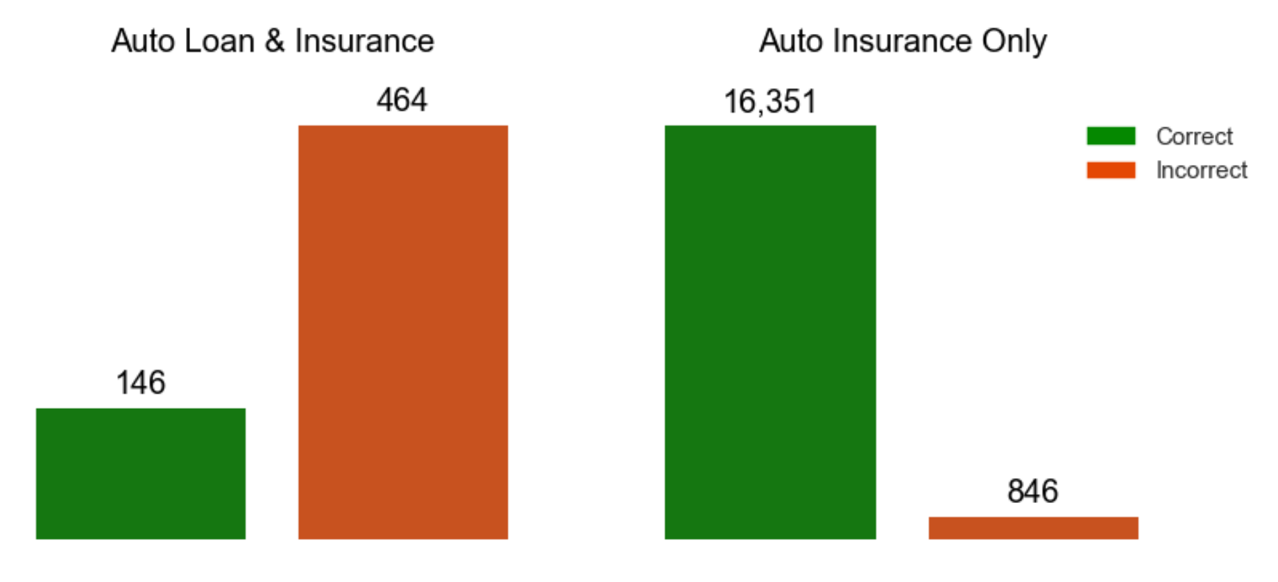
GBT - Auto Loan vs. Both Products
Findings
92.63% of all predictions were correct.
23.28% of all predictions for customers having both policies were correct.
Of all actual customers who had both policies, we predicted 14.71% of them correctly.
Notes:
Luke
recall= TP/TP + FN True Positive predicted compared to all true positives
Precision= TP/TP+FP Of all positive predictions

Slide 14
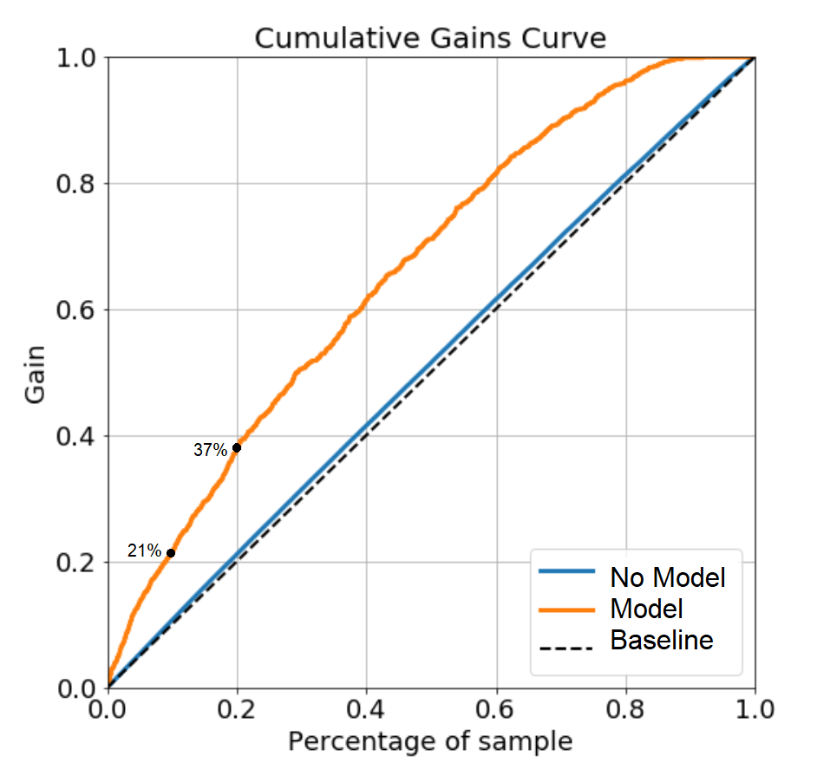
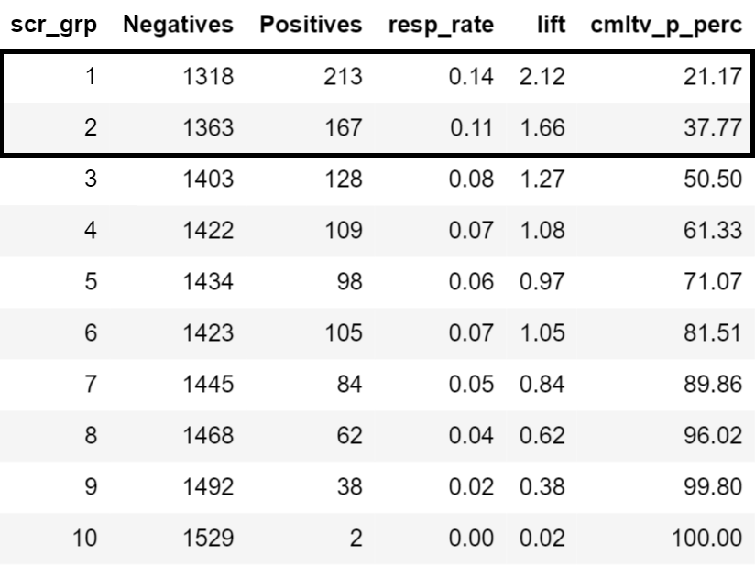
Gains Curve - Auto Loan vs. Both Products
Findings
Top 10% of customers contain approximately 21% of responses
Top 20% of customers contain approximately 37% of the responses
Notes:
Luke

Slide 15
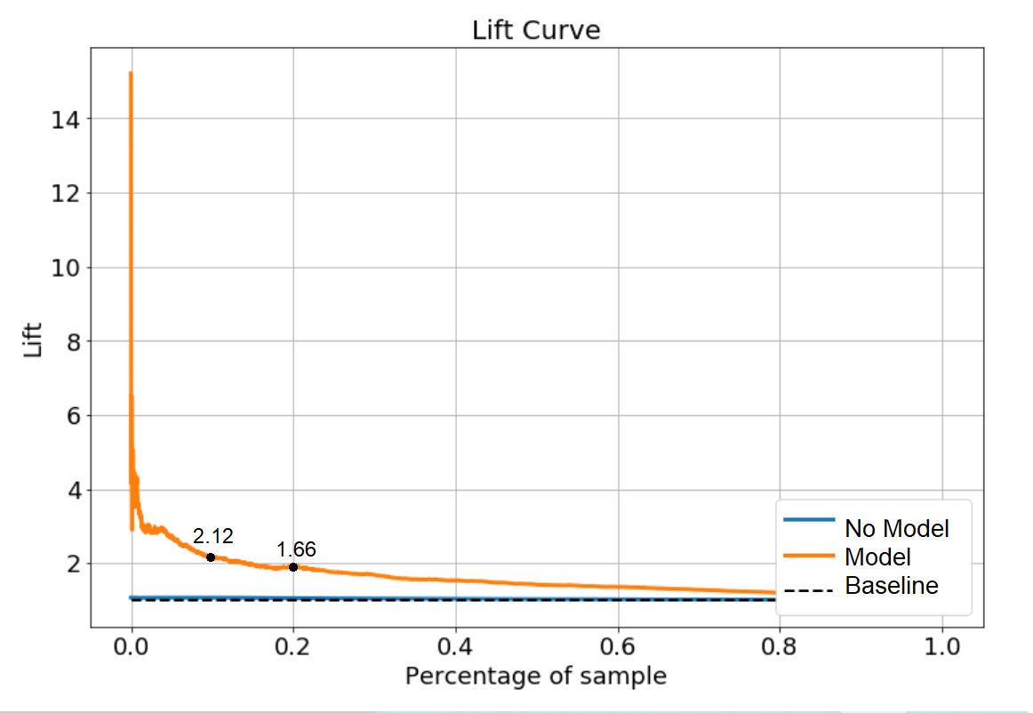
Lift Curve - Auto Loan vs. Both Products
Findings
The orange line represents the total lift our model provides compared to the blue line which is if we had no model and picked randomly.
For the top 10% of customers, our model is 2.12 times better then without out it
For the top 20% it’s 1.66 times better.
Notes:
Luke

Slide 16
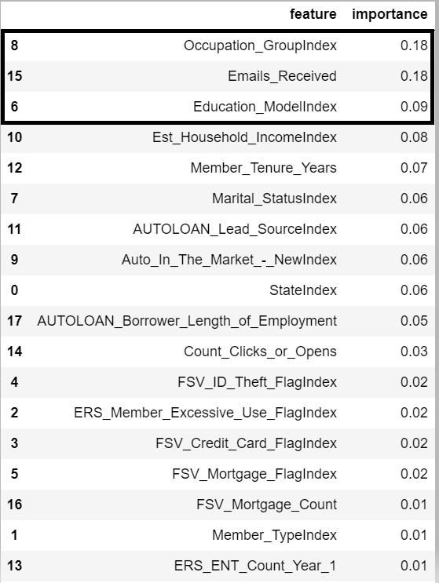
Important Features - Auto Loan vs. Both Products
#1 Occupation_Group
Ex: Management, Professional, etc.
#2 Emails_Received
Number of emails customers have received from AAA over a period of time
#3 Education_ModelIndex
Ex: Completed high school, college, or neither
Notes:
Luke

Slide 17
Auto Insurance vs. Auto Insurance and Loan
Notes:
Sean

Slide 18
Features Included- Auto Insurance vs. Both Products
Individual
Mortgage Count
State
Mortgage Flag
Total Travel Records
Credit Card Flag
Member Count
Count Clicks or Opens
Driving School Flag
TrueCar Leads Count
INS Policy
Total Claims
Length of Auto Insurance
Individual 2 (Demographics)
Exact Age Decode
ID Theft Flag
Emails Received
Priceline Count
Education Model
Occupation Group
Marital Status
Household
Est. Household Income
Auto In The Market- Used
Members
Member Tenure Years
Notes:
Sean
recall= TP/TP + FN
Precision= TP/TP+FP
https://www.datascienceblog.net/post/machine-learning/interpreting-roc-curves-auc

Slide 19
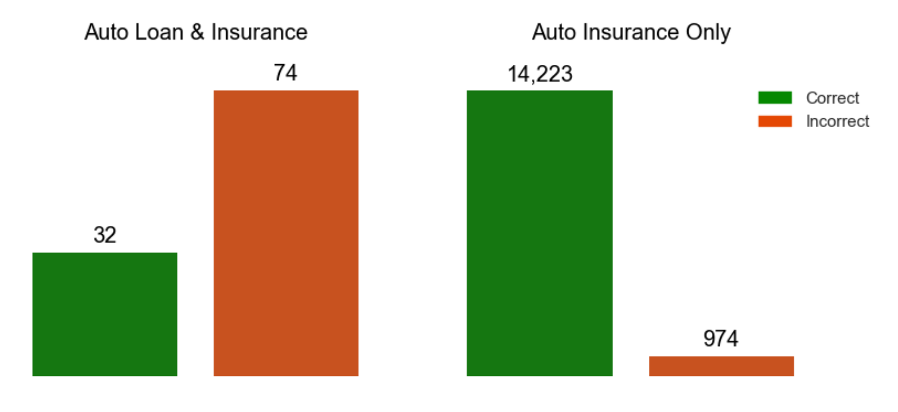
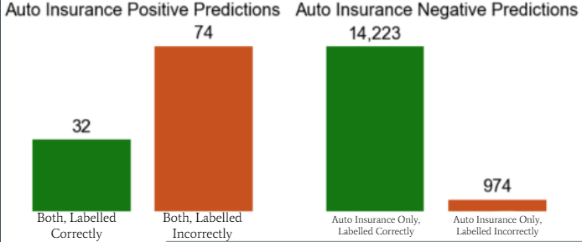
Random Forest - Auto Insurance vs. Both Products
Findings
93% of all predictions were correct.
30% of all predictions for customers having both policies were correct.
Of all actual customers who had both policies, we predicted 3% of them correctly.
Notes:
Sean
recall= TP/TP + FN
Precision= TP/TP+FP
https://www.datascienceblog.net/post/machine-learning/interpreting-roc-curves-auc

Slide 20
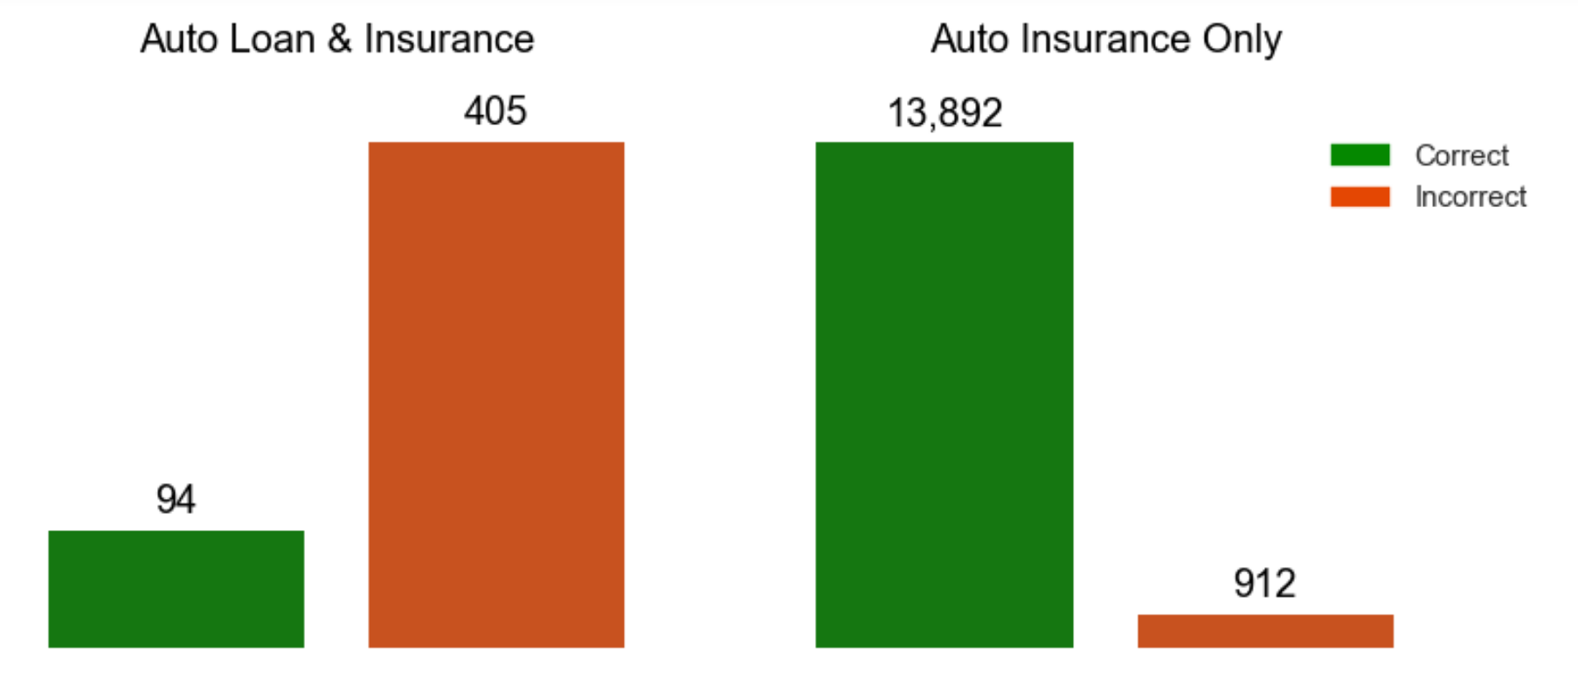
GBT - Auto Insurance vs. Both Products
Findings
91% of all predictions were correct.
19% of all predictions for customers having both policies were correct.
Of all actual customers who had both policies, we predicted 9% of them correctly.
Notes:
Sean
recall= TP/TP + FN
Precision= TP/TP+FP
https://www.datascienceblog.net/post/machine-learning/interpreting-roc-curves-auc

Slide 21
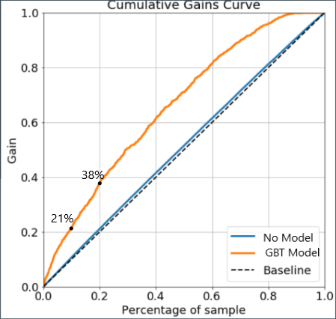
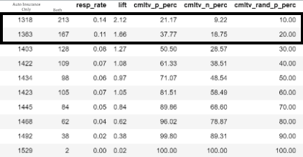
Gains Curve (GBT) - Auto Insurance vs. Both Products
Findings
By contacting 20% of customers (top 2 deciles), you will gain approx. 38% of total sales by using this model
Auto Insurance Only
Both
Notes:
Sean

Slide 22
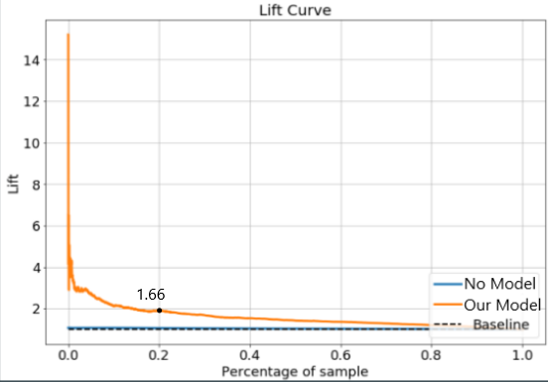
Lift Curve (GBT) - Auto Insurance vs. Both Products
Findings
Lift is a measure of the effectiveness of a predictive model represented by the ratio between the results obtained with and without the predictive model
At a percentage sample of .2, using no model we predict 20% of total sales and using the model we predict 38% of total sales (lift is 1.66)
Notes:
Sean https://towardsdatascience.com/evaluate-model-performance-with-cumulative-gains-and-lift-curves-1f3f8f79da01#_=_

Slide 23
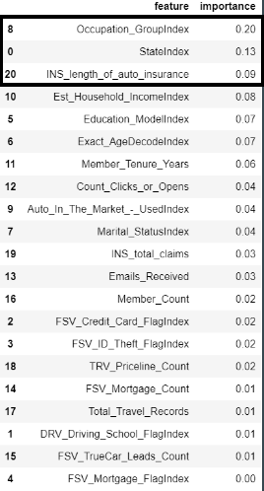
Important Features (GBT)- Auto Insurance vs. Both Products
#1 Occupation_Group
Ex: Management, Professional, etc.
#2 StateIndex
Customer state abbreviation
#3 INS_Length_Of_AutoIns
Difference between original start date of the policy and current date
Notes:
Luke

Slide 24
Recommendations
Target married and educated segments
Members with high email responsivity
Members who have policies already
Targeting the top 5 deciles will result in approximately 80% of the responses
Outside the box: Incentivising or bundling the two services can increase potential customers
Notes:
Cadri

